Slide 1
OOP with Java(Java PART I)
Introduction To Java
https://shorturl.at/hKGam
Notes:
https://shorturl.at/cmLS0

Slide 2
Purpose of The Module
OOP with Java aims to equip you with knowledge and skills necessary to apply in software development using Java.
You will be able to describe Java basics, Implement Object Oriented Programming.
You will be able to develop Graphical User Interfaces applications, Apply Java Network Programming and Interact with databases using Java Database Connectivity.
The module will use different features you have learned previously such as:
Fundamentals of Programming with C
Basics of Database development
And many more

Slide 3
What is Java?
1.1 Definition
Java is an object-oriented, popular, general-purpose programming language and computing platform developed by James Gosling and colleagues at Sun Microsystems in the early 1990s. Java is designed to be high level, fast, reliable, Scrabble, platform-independent, and secure.
Considering the number of Java developers, devices running Java, and companies adapting it, it's safe to say that Java will be around for many years to come.
Java is a platform as well as a language
The Java platform allows software to be developed and used across different architectures and operating systems
I.2. Java platforms
There are four platforms of the Java programming language as part of the Java software platform family in general. Actually, java itself is a set of platforms.

Slide 4
Java Platform, Standard Edition (J2SE)
Java Platform, Standard Edition (Java SE) is a computing platform for development and deployment of portable code for desktop and server environments.[1] Java SE was formerly known as Java 2 Platform, Standard Edition (J2SE).
The platform uses Java programming language and is part of the Java software-platform family. Java SE defines a range of general-purpose APIs—such as Java APIs for the Java Class Library—and also includes the Java Language Specification and the Java Virtual Machine Specification. OpenJDK is the official reference implementation since version 7

Slide 5
Java Platform, Micro Edition or Java ME
Java Platform, Micro Edition or Java ME is a computing platform for development and deployment of portable code for embedded and mobile devices (micro-controllers, sensors, gateways, mobile phones, personal digital assistants, TV set-top boxes, printers).
Java ME was formerly known as Java 2 Platform, Micro Edition or J2ME. As of December 22, 2006, the Java ME source code is licensed under the GNU General Public License, and is released under the project name phoneME

Slide 6
Java Platform, Enterprise Edition (Java EE)
Java Enterprise Edition (Java EE), formerly named:” Java 2 Platform, Enterprise Edition (J2EE)”, currently rebranded as Jakarta EE, is a set of specifications, extending Java SE 8 with specifications for enterprise features such as distributed computing and web services. Java EE applications are run on reference runtimes, which can be microservices or application servers, which handle transactions, security, scalability, concurrency, and management of the components.
Java EE specification defines APIs and their interactions. As with other Java Community Process specifications, providers must meet certain conformance requirements in order to declare their products as Java EE compliant.

Slide 7
JavaFX
OpenJFX is an open-source, next-generation client application platform for desktop, mobile and embedded systems built on top of Java.
It is a collaborative effort by many individuals and companies with the goal of producing a modern, efficient, and fully featured toolkit for developing rich client applications
The platform is also for creating and delivering rich Internet applications (RIAs) that can run across a wide variety of devices. JavaFX is intended to replace Swing as the standard GUI library for Java SE, but both will be included for the foreseeable future. JavaFX has support for desktop computers and web browsers on Microsoft Windows, Linux, and macOS. Since the JDK 11 release in 2018, JavaFX has been part of the open-source OpenJDK, under the OpenJFX project. Thanks to the open source foundation and community.

Slide 8
Java Components
Java architecture consists of three main components and those are JRE(Java Runtime Environment), JDK(Java Development Kit), and JVM(Java Virtual Machine)
Java Runtime Environment (JRE)
This a virtual machine which runs programs which have been compiled
Contains a large library of classes for lots of different purposes
Java programs can run in a runtime environment created by the JRE software. The Java Runtime Environment (JRE) is a disk-based system that mixes Java code with necessary libraries. Finally, the Java Virtual Machine (JVM) begins to run the Java code. The Java Runtime Environment (JRE) contains all of the libraries and software required to run Java programs. Although JRE is included in the JDK, it is also available for download individually.
Java Development Kit (JDK)
It’s a Java application and applet development environment. JRE, a compiler, an interpreter or loader, and a number of development tools are all included in the Java Development Kit. Now we will walk through these development tools which come along with JDK:
Java(loader/executor): responsible for launching Java applications
javac(compiler): It is responsible for compilation of java programs
Javadoc: provides support for generation of API documentation
Jar: responsible for creating and managing all JAR files.
3. Java Virtual Machine(JVM)
WORA is Java’s most important feature. Write Once, Run Anywhere is an acronym for WORA. We may develop our code once and utilize it anywhere and on any operating system, according to the feature. Due to the Java Virtual Machine, our Java software can execute on any platform. It is a Java platform component that provides us with a platform in which we can run Java programs. The basic job of the JVM is to transform byte code into machine code. On the whole, JVM performs these functions – loads and verifies the code and then executes the code, and enables the runtime environment.

Slide 9
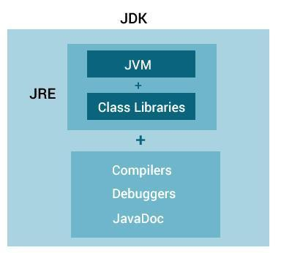
Java Components

Slide 10
Did you know?
In 1995, The Language "Java“ was pronounced and it was already a trademark by Oak Technologies,
Java was named that to mean "Simple, Robust, Portable, Platform-independent, Secured, High Performance, Multithreaded, Architecture Neutral, Object-Oriented, Interpreted, and Dynamic".
Java is an island of Indonesia where the first coffee was produced (called java coffee) and the team was gathered taking a coffee with the objective to choose a name. The Java name was chosen by James Gosling while having coffee near his office again. Some conspiracy stated that he was inspired by the fact that they alway gather around a coffee and concluded that something related to coffee would be amazing.
Initially developed by James Gosling at Sun Microsystems and released in 1995 , now a subsidiary of Oracle Corporation .

Slide 11
Installation of Java environment
To install Java on Windows and run Java apps on Microsoft’s operating system, you need to obtain a copy of the Java Development Toolkit (JDK) installation media.
The JDK includes both a Java Runtime Environment (JRE) and a Java Virtual Machine (JVM).
The JDK also includes a number of programming tools, like a compiler and a Java web server, for programmers who need to install Java on Windows.
Which Java distribution should I choose?
Many companies, including Oracle, Azul, Amazon and Microsoft provide their own Java installers, all of which are based on the open source OpenJDK project. You may choose the latest version or the LTS version which is currently java 17.
windows Users
Download OpenJDK from
https://jdk.java.net/21/
Unzip and add to a Java folder in C:\Program files
Add the C:\Program Files\java\jdk-21\bin folder to Path environment Variable
Create JAVA_HOME environment variable that point to the C:\Program Files\java\jdk-21
Use command line to check java version with java --version
Linux users
>Sud apt install default-jdk
Then Use java –version to check the version
Next, you can type, Which java to check the path

Slide 12
JDK Installer WIndows
JDK Installation Instructions for Windows
You run a self-installing executable file to unpack and install the JDK on Windows computers.
Install JDK on Windows computers by performing the actions described in the following topics:
https://docs.oracle.com/en/java/javase/11/install/installation-jdk-microsoft-windows-platforms.html#GUID-A740535E-9F97-448C-A141-B95BF1688E6F

Slide 13
Java Buzz Words: Key Considerations for Java as a language
The fundamentals forces of Java invention are portability and security. But there are other key factors that contributed to the final form of Java Language we have today. The key considerations were summed up by the Java team in the following list of Buzzwords:
Simple
Secure
Portable
Object Oriented
Robust
Multithreaded
Architectural neutral
Interpreted
High Performance
Distributed
Dynamic

Slide 14
Key features Considerations
Simple
Java was designed to be easy for the professional programmer to learn and use effectively. If you have another programming language experience, you will not find java hard to master. If you understand basic concepts of Object Oriented Programming, learning Java will be even easier. If you are experienced C/C++ syntax and many of the OOP features of C++, most Programmers have little trouble in learning Java.
Object Oriented
Java brought ”Everything is an Object” paradigm. The Object model in java is simple and easy to extend, while primitive types such as integers were kept as high performance non objects.
Robust
The multiplatformed environment of the web places extraordinary demand on the program, because the program must execute reliably in a variety of systems. Thus, the ability to create robust program was given a highest priority in the design of Java. To gain reliability, Java restricts you in a few key areas to force you to find your mistakes early in a program development. Knowing that what you have written will behave in a predictable way under diverse conditions is a key feature in Java.
Java eliminates virtually problems of memory management mistakes by managing memory allocation and deallocation for you. Deallocation is automatic as Java provide Garbage Collection for Java unused Objects.
Exceptional handling in a traditional programming often arise such as division by zero or “file not found” and these must be managed hardly. Java helps in this area by providing an object oriented exception handling. In a well written program, all run-time errors can and should be managed by your program

Slide 15
Java Features(next…)
Multithreaded
Java was designed to meet the real world requirement of creating interactive, networked programs. To accomplish this, Java supports multithreaded programming which allows you to write programs that do many things similtaneouly. The java run time system has a solution for multiprocess synchronization that enables you to construct smoothly running interactive systems.
Architectural neutral
A central issue for the Java designers was that of code longevity and portability. At the time of Java's creation, one of the main problems facing programmers was that no guarantee existed that if you wrote a program today, it would run tomorrow-even on the same machine. Operating system upgrades, processor upgrades, and changes in core system resources can all combine to make a program malfunction. The Java designers made several hard decisions in the Java language and the Java Virtual Machine in an attempt to alter this situation. Their goal was "write once; run anywhere, any time, forever?" To a great extent, this goal was accomplished.
Interpreted and High Performance
As described earlier, Java enables the creation of cross-platform programs by compiling into an intermediate representation called Java bytecode. This code can be executed on any system that implements the Java Virtual Machine. Most previous attempts at cross-platform solutions have done so at the expense of performance. As explained earlier, the Java bytecode was carefully designed so that it would be easy to translate directly into native machine code for very high performance by using a just-in-time compiler. Java run-time systems that provide this feature lose none of the benefits of the platform-independent code.

Slide 16
Java Features( next …)
Distributed
Java is designed for the distributed environment of the Internet because it handles TCP/IP protocols. In fact, accessing a resource using a URL is not much different from accessing a file. Java also supports Remote Method Invocation (RMI). This feature enables a program to invoke methods across a network.
Dynamic
Java programs carry with them substantial amounts of run-time type information that is used to verify and resolve accesses to objects at run time. This makes it possible to dynamically link code in a safe and expedient manner. This is crucial to the robustness of the Java environment , in which small fragments of bytecode may be dynamically updated on a running system.

Slide 17
Java Editors
There are numerous IDE for Java that offer smart code completion and validate errors in real time. Choosing the best Java IDE from a number of options could be a challenge.
Here is a list of popular IDE you may use
Eclipse
IntelliJ IDEA

Slide 18
Syntax Of Java
The syntax of Java is largely derived from C++. However, unlike C++, which combines the syntax for structured, generic, and object-oriented programming, Java was built from the ground up to be virtually fully object-oriented: everything in Java is an object with the exceptions of atomic data types (ordinal and real numbers, boolean values, and characters) and everything in Java is written inside a class.
…everything in Java is written inside a class.
…everything in Java is written inside a class.
…everything in Java is written inside a class.
…everything in Java is written inside a class.
…everything in Java is written inside a class.
…everything in Java is written inside a class.

Slide 19
First Java Program
Create a .java file
Define a class (should have the same name as the Java file)
Add a the main method
Call System.out.println(…) to print something
Console
Compile with javac
Run the file with java
IDE
Compile and run as Java Application
public static void main(String[] args) { ... }

Slide 20
Example 2: Write and run the program
class HelloWorld {
public static String details( String country, String names){
return names+" from "+country;
}
/**
Main method or entry point of the program
*/
public static void main(String[] args) {
System.out.println("Hello, World! ");
System.out.println(" I am "+details("Rwanda", "Java Mike"));
}
}

Slide 21
The compiler
Converts the .java files to Java bytecode
Reports any errors that prevented it from completing, or warnings that the developer should consider
Tells the developer what is wrong
Gives the source file and line number

Slide 22


A C/C++ program…
Source file(s)
Compiler
Machine code
int main() {
}
0101110001011011010101010101
For example…
Runs on an x86
processor
Test.c
gcc.exe
Text.exe
containing
x86 instructions

Slide 23

A Java program…
Source file(s)
Compiler
Java byte code
Virtual machine(s)
class Test {
…
}
store x
pop y
load z
For example…
Test.java
javac.exe
Test.class

Slide 24
Example
Write the source file
class Kigali {
public static void main(String[] args){
System.out.println("Hello Kigali!");
}
}
Compile the class file
$ javac Kigali.java
Kigali.class
Run the class file in the virtual machine
$ java Kigali
$ Hello Kigali
View the ouput

Slide 25
More detail…
Note1: It is a good practice to name file the same name with the class even if it is not mandatory
Access modifier
No return value
Method name
A method argument
public class Kigali{
public static void main(String[] args){
System.out.println("Whats up Kigali!");
}
}
Output text to the console
Note 2: The Entry point
Each application in Java has an entry point to start from. It is a public static method called main. Arguments to application are passed through args parameter: the array of unknown numbers of strings.
public static void main(String[] args) {}

Slide 26

Launch time
Calling the java program launches the JVM
You specify the name of the class and any arguments to send it, e.g.
The JVM searches the class for a method called main, and then calls that method
It sends the arguments (e.g. "Hello" and "4") as items in the array called args
$ java Kigali "Hello" 4

Slide 27
A Java source file
public class Person{
void talk(){
int x = 5;
}
void walk(){
}
}
A statement
A class
A method
public, class, void and int are all Java keywords

Slide 28
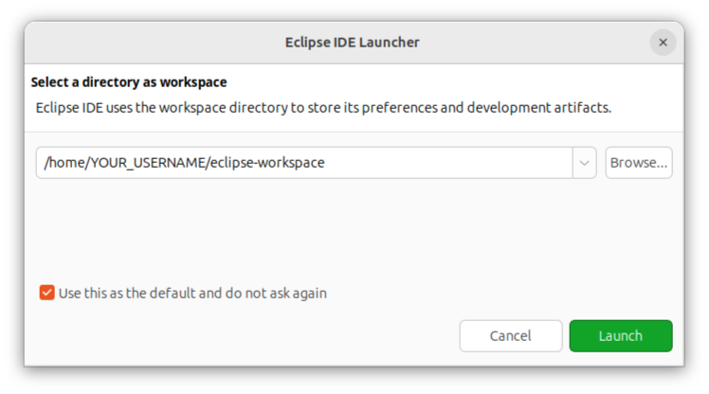
Workspace
After installing Eclipse, you can select a workspace. The workspace is the directory where most projects are located.Upon selecting a workspace, it will show a Welcome screen presenting you with multiple options.

Slide 29
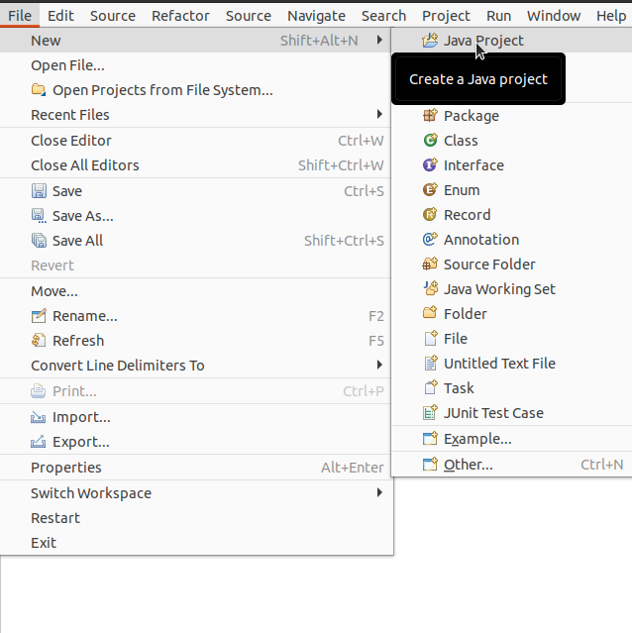
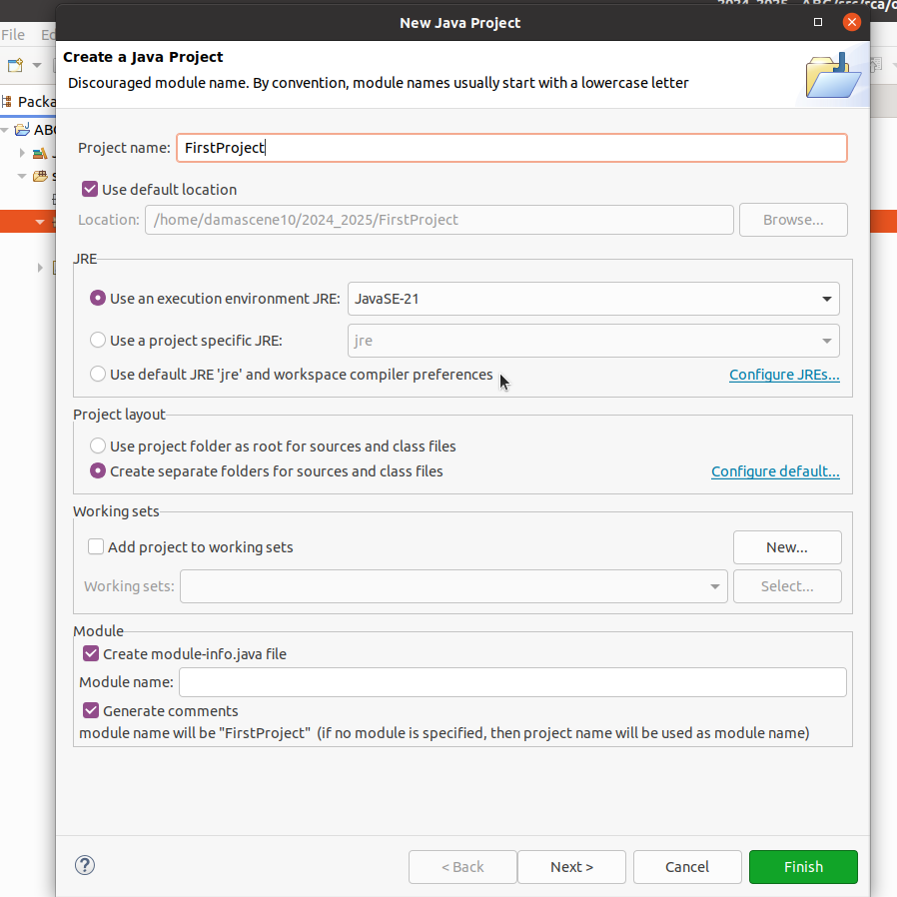
New Java Project
After installing Eclipse you should have an empty workspace. To Create the new Project,follow the following steps:
By clicking on the File menu and choosing New →Java Project.
Enter the Project Name
Select the Java Runtime Environment (JRE) or leave it at the default
Select the Project Layout which determines whether there would be a separate folder for the source codes and class files. The recommended option is to create separate folders for sources and class files.

Slide 30
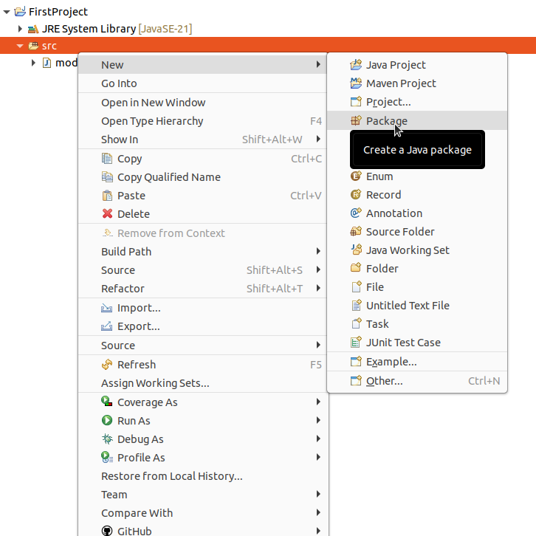
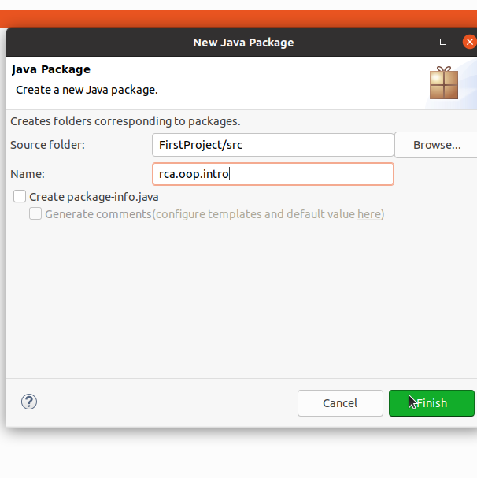
Create a Package
The package in java is used to group multiple classes together. It is created by Right click on the src folder and selecting New → Package. Once the Java Package wizard comes up:
Enter/confirm the source folder name.
Enter the package name.
Click on the Finish button.

Slide 31
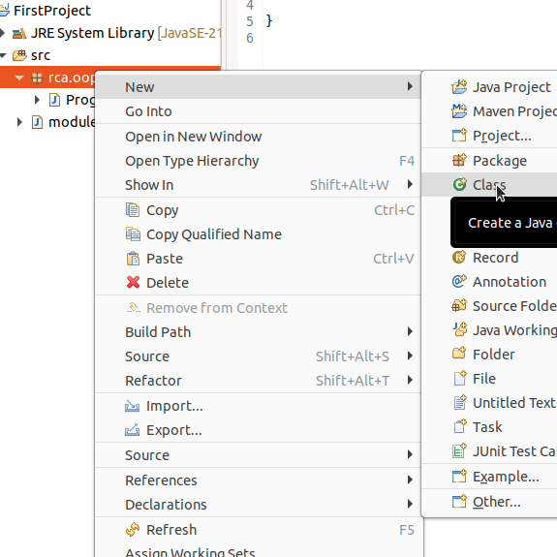
Create a class
You can use the New Java Class wizard to create a Java class. The Java Class wizard can be invoked in different ways:
By clicking on the File menu and selecting New → Class.
Ensure the source folder and package are correct.
Enter the class name.
Select the appropriate class modifier.
Enter the super class name or click on the Browse button to search for an existing class.
Examine and modify the check boxes related to method stubs and comments.

Slide 32

Statements
A statement does something, e.g.
Declaring a variable, int x;
Assigning a value to a variable, x = 10;
Incrementing a variable, x++;
Calling a method, System.out.println(“X”);
Statements are separated by semi-colons, e.g
x = 10; y = x;

Slide 33
Expressions
An expression evaluates to a value, e.g.
10 + 2 * 3 / 4
"Hello" + " world"
3
"kind of.."
A statement can be an expression if it evaluates to a value, e.g.
x = 10
Math.sin(5)
11
"Hello world"
3
"kind of.."
10 e.g. y = (x = 10);
-0.9589...

Slide 34
The Comments
We have use comment like:
/**
Main method or entry point of the program
*/
You have seen other things like this : // Printing a text to the console
All of the above are comments, ie. they are not compiled nor executed as part of our program.
The text between /** and */ is a special comment, called Javadoc. Using this commenting technique, one may automatically generate documentation for properly commented sources.
This kind of commenting is accepted outside classes and methods
The text after “//” is a normal text comment used inside a code block like methods,loops,...
We can also have comments between :”/* and */”

Slide 35

Variables
A value is stored in a variable so that it can be used elsewhere in a program, e.g.
Variables can be primitive types or object references
int x = 10;
Initial value (optional)
Variable type
Variable name

Slide 36
Java Variables
The Java programming language uses both "fields" and "variables" as part of its terminology. Instance variables (non-static fields) are unique to each instance of a class. Class variables (static fields) are fields declared with the static modifier; there is exactly one copy of a class variable, regardless of how many times the class has been instantiated. Local variables store temporary state inside a method. Parameters are variables that provide extra information to a method; both local variables and parameters are always classified as "variables" (not "fields"). When naming your fields or variables, there are rules and conventions that you should (or must) follow.
The eight primitive data types are: byte, short, int, long, float, double, boolean, and char. The java.lang.String class represents character strings. The compiler will assign a reasonable default value for fields of the above types; for local variables, a default value is never assigned. A literal is the source code representation of a fixed value. An array is a container object that holds a fixed number of values of a single type. The length of an array is established when the array is created. After creation, its length is fixed.

Slide 37

Primitive types
These are the types which are part of the Java language
boolean true or false (1bit)
byte a 8bit signed number
char a 16bit Unicode character
short a 16bit signed number
int a 32bit signed number
long a 64bit signed number
float a 32bit floating-point number
double a 64bit floating-point number

Slide 38
Primitive types and Casting
You can generally assign the value of a smaller primitive type to a larger one, e.g.
But not the other way around
To assign a value to a smaller type, you have to use the cast operator, e.g.
short big = 5646;
int bigger = big;
long biggest = bigger;
long big = 3453434623426;
int notSoBig = big;
short evenSmaller = notSoBig;
Compiler error!
long big = 3453;
int notSoBig1 = big;
int notSoBig2 = (int)big;
short smaller = (short)big;
Compiler error!
Works

Slide 39
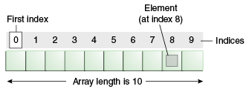
Arrays in Java
An array is a container object that holds a fixed number of values of a single type. The length of an array is established when the array is created. After creation, its length is fixed. You have seen an example of arrays already, in the main method of the "Hello World!" application. This section discusses arrays in greater detail.
An array of 10 elements.
Each item in an array is called an element, and each element is accessed by its numerical index. As shown in the preceding illustration, numbering begins with 0. The 9th element, for example, would therefore be accessed at index 8.

Slide 40
Arrays
Array Length
To find out how many elements an array has, use the length property:
String[] vehicles = {"Volvo", "BMW", "Ford", "Mazda"};
System.out.println(vehicles.length);
// Outputs 4
Loop Through an Array
You can loop through the array elements with the for loop, and use the length property to specify how many times the loop should run.
The following example outputs all elements in the vehicles array:
String[] vehicles = {"Volvo", "BMW", "Ford", "Mazda"};
for (int i = 0; i < vehicles.length; i++) {
System.out.println(cars[i]);
}

Slide 41
Array Examples
The following program, ArrayDemo, creates an array of integers, puts some values in the array, and prints each value to standard output. Access is done using index
class ArrayDemo {
public static void main(String[] args) {
// declares an array of integers
int[] anArray;
// allocates memory for 10 integers
anArray = new int[10];
// initialize first element
anArray[0] = 100;
// initialize second element
anArray[1] = 200;
// and so forth
anArray[2] = 300;
anArray[3] = 400;
anArray[4] = 500;
anArray[5] = 600;
anArray[6] = 700;
anArray[7] = 800;
anArray[8] = 900;
anArray[9] = 1000;
System.out.println("Element at index 0: "+ anArray[0]);
System.out.println("Element at index 1: "+ anArray[1]);
System.out.println("Element at index 2: "+ anArray[2]);
System.out.println("Element at index 3: "+ anArray[3]);
System.out.println("Element at index 4: "+ anArray[4]);
System.out.println("Element at index 5: "+ anArray[5]);
System.out.println("Element at index 6: "+ anArray[6]);
System.out.println("Element at index 7: "+ anArray[7]);
System.out.println("Element at index 8: "+ anArray[8]);
System.out.println("Element at index 9: " + anArray[9]);
}
}
The output from this program is:
Element at index 0: 100
Element at index 1: 200
Element at index 2: 300
Element at index 3: 400
Element at index 4: 500
Element at index 5: 600
Element at index 6: 700
Element at index 7: 800
Element at index 8: 900
Element at index 9: 1000

Slide 42
Array (next)
The above program can be shorterned using a loop to print the array
class ArrayDemo {
public static void main(String[] args) {
// declares an array of integers
int[] anArray;
// allocates memory for 10 integers
anArray = new int[10];
// initialize first element
anArray[0] = 100;
// initialize second element
anArray[1] = 200;
// and so forth
anArray[2] = 300;
anArray[3] = 400;
anArray[4] = 500;
anArray[5] = 600;
anArray[6] = 700;
anArray[7] = 800;
anArray[8] = 900;
anArray[9] = 1000;
for(int i=0; i<anArray.length;i++){
System.out.println(" The element at "+i+ " is "+anArray[i]);}
}
}
The output from this program is:
Element at index 0: 100
Element at index 1: 200
Element at index 2: 300
Element at index 3: 400
Element at index 4: 500
Element at index 5: 600
Element at index 6: 700
Element at index 7: 800
Element at index 8: 900
Element at index 9: 1000

Slide 43
Array example 2
class SimpleProgram
{
public static void main(String[] arg)
{
{
int[] marks = { 125, 132, 95, 116, 110 };
int highest_marks = maximum(marks);
System.out.println("The highest score is " + highest_marks);
}
}
public static int maximum(int[] numbers)
{
int maxSoFar = numbers[0];
// for each loop
for (int num : numbers)
{
if (num > maxSoFar)
{
maxSoFar = num;
}
}
return maxSoFar;
}
}

Slide 44

Objects
These are complex types which are defined in the JDK or in your code, .
String - a sequence of characters
Date - a date and time value
An object is created in memory using the new keyword, e.g.
Variable references aren't objects themselves
They reference an object in memory
An object is a software bundle of related state and behavior. Software objects are often used to model the real-world objects that you find in everyday life. This lesson explains how state and behavior are represented within an object, introduces the concept of data encapsulation, and explains the benefits of designing your software in this manner.
String s1 = new String("Hello");
The object's class
The object itself
Reference variable
Memory
s1
"Hello"

Slide 45
Objects
Reference variables can be null which means they don't reference an object anymore, e.g
A variable can be changed to reference a different object, e.g.
s1
s1 = null;
Memory
Variable points to nothing...
"Hello"
Object still exists in memory
Memory
s1 = new String("World");
s1
"Hello"
"World"

Slide 46
Objects and Garbage Collection
And more than one variable can reference the same object, e.g.
This is process which runs in the background looking for objects with no references
It deletes such objects from memory to free space for new objects
Memory
String s2 = s1;
s1
"Hello"
s2
"World"
Memory
Memory
s1
GC
"Hello"
"World"
s2
"World"

Slide 47
Equality
Two types of equality...
Reference equality x == y
Checks if the variables reference the same object in memory
Object equality x.equals(y)
Checks if the objects which the variables reference are equal, i.e. have the same meaning or content
E.g. for Strings - do they have the same characters?

Slide 48

Equality example
s1 and s2 reference the same object so s1 == s2 is TRUE
s1 and s3 reference different objects so s1 == s3 is FALSE even though the strings are the same
String s3 = new String("World");
Memory
s1
"Hello"
s2
"World"
s3
"World"

Slide 49
Equality example
s1 and s3 reference String objects with the same content so s1.equals(s3) is TRUE
Summary... s1 == s2 TRUE s1 == s3 FALSE s1.equals(s2) TRUE s1.equals(s3) TRUE
Memory
s1
"Hello"
s2
"World"
s3
"World"

Slide 50
Strings are an exception...
Strings can be created in two ways...
s1 and s2 will reference different objects so s1 != s2
But s2 and s3 will point to the same object so s2 == s3
s2 and s4 will not so s2 != s4
String s1 = new String("Hello");
String s2 = "Hello";
String s3 = "Hello";
String s4 = "World";
As a normal object in memory
As literals which go into the "String pool"

Slide 51
Variable terminology
Instance variable - it's available anywhere in the class instance
public class SuperApp {
int count = 0;
void setCount(int c) {
count = c;
}
void print() {
String s = "Val = " + count;
System.out.println(s);
}
}
Method parameter - it's available only in the method
Local variable - it's available only in the method

Slide 52
Variable scope
a
public class SuperApp {
int a = 10;
SuperApp {
foo(a);
}
void foo(int b) {
int c = b;
for (int d = 0; d < c; d++) {
int e = d;
System.out.println(e);
}
}
}
The scope of a variable is where it can be accessed in your code
b
c
d
e

Slide 53

Naming conventions
The compiler won't complain if you don't stick to these, but we will!
Entity | Convention | Examples
Class name | Camelcase, starts uppercase Also known as (PascalCase) | HelloWorldProgram PatientViewPage
Method name | Camelcase, starts lowercase | getPatientCount main
Variable | Camelcase, starts lowercase | numPatients listOfUsers
Constant | Uppercase with underscores | MAX_PATIENT_AGE DEFAULT_USER

Slide 54
Flow control: if-else
if (condition) {
}
else if (another condition) {
}
else {
}
if (a == b) {
doMethod();
}
else if (isJava()) {
a = 10;
}
else {
out.println("X");
}
if (a < x) {
a = 5;
}
if (a < x)
a = 5;
If only one statement follows the if or else if, then the braces aren't needed

Slide 55
Flow control: while / do-while
while (condition) {
// loop these statements
}
while (a < 10) {
out.println(a);
a++;
}
do {
// loop these statements
}
while (condition);
do while means that the statements will always been executed at least once

Slide 56
Flow control: for
for (statement; condition; statement) {
// loop these statements
}
for (int i = 0; i < 10; i++) {
System.out.println(i);
}
int i = 0 ;
while (i < 10) {
System.out.println(i);
i++;
}
for is a alternative way to write a while loop

Slide 57
Flow control: continue/break
for (int i = 0; i < 10; i++) {
if (i == x)
break;
else if (i == z)
continue;
System.out.println(i);
}
break causes the for loop to finish immediately
continue goes to the next iteration if there will be one

Slide 58
Flow control: switch
switch (variable) {
case <value1>:
statements
break;
case <value2>:
statements
break;
default:
statements
}
switch (choice) {
case 'Y':
doThing();
break;
case 'N':
exitProgram();
break;
default:
showHelp();
}
e.g
switch can work with byte, char, short and int values

Slide 59
Flow control: switch
switch (choice) {
case 'Y':
doThing();
break;
case 'N':
exitProgram();
break;
default:
showHelp();
}
if (choice == 'Y')
doThing();
else if (choice == 'N')
exitProgram();
else
showHelp();
switch is often a better way of writing an if-else statement

Slide 60
Flow control: switch\zzz
switch (choice) {
case 'Y':
doThing();
case 'N';
case 'X';
exitProgram();
break;
default:
showHelp();
}
What happens now when choice equals 'Y'?
What about 'X'?

Slide 61
OOP Concepts

Slide 62
Why OOP?
OOP features were incorporated into programming languages to help developers produce code that is:
Easier to test and so of higher quality
Easier to maintain
Easier to re-use in future projects
OOP seeks to achieve these objectives by making code more modularized (i.e. data is stored self-sufficient classes)

Slide 63
OOP principles/concepts/pillars
Object-oriented programming generally referred to as OOPS is the backbone of java as java is not a purely object oriented language but it is object oriented language. Java organizes a program around the various objects and well-defined interfaces. There are four pillars been here in OOPS which are listed below. These concepts aim to implement real-world entities in programs.
Encapsulation
Abstraction
Abstract classes
interfaces
Inheritance
Polymorphism
Overloading
Overriding

Slide 64
In the Beginning…
There was just memory!
If you wanted to store a value, you had to pick a memory address
Store value at 01
Addr | Value
00 | 'A'
01 | 'B'
02 | 2
03 | 3
My Program
Load value at 03

Slide 65
Then there were variables
A variable allowed the programmer to give a piece of memory a name, which the compiler would remember
Set value of mychar2
Variable | Value
mychar1 | 'A'
mychar2 | 'B'
myint1 | 2
myint2 | 3
My Program
Get value of myint2

Slide 66
But what about complex data…
Variables only worked for simple data types like integers and characters
For example a coordinate consists of an x value and a y value. With just variables we would have to create two variables for each coordinate
int myCoord1_X = 2
int myCoord1_Y = 4
int myCoord2_X = 8
int myCoord2_Y = -2

Slide 67
Then there were structures
A structure (as it was called in C) allowed simple values to be grouped into more complex data types
So we could define a new data type – like a Coordinate data type…
struct Coordinate {
int x
int y
}
Coordinate c1 = { 2, 4 }
Coordinate c2 = { 8, -2 }

Slide 68

Working with structures
Typically a programmer would create a set of functions which operated on a given structure
struct Coordinate {
int x
int y
}
coordinate_draw(Coordinate c) {
// Code to draw a coordinate
}
coordinate_reset(Coordinate c) {
// Code to draw a coordinate
}

Slide 69
Member functions (methods)
Eventually someone realized that life would be easier if structures could have their own functions…
class Coordinate {
int x
int y
draw() {
// Code to draw a coordinate
}
reset() {
// Code to draw a coordinate
}
}
And the called it a class!

Slide 70
Classes vs. Objects
An object is a software bundle of related state and behavior. Software objects are often used to model the real-world objects that you find in everyday life. This lesson explains how state and behavior are represented within an object, introduces the concept of data encapsulation, and explains the benefits of designing your software in this manner.
A class is a blueprint or prototype from which objects are created. This section defines a class that models the state and behavior of a real-world object. It intentionally focuses on the basics, showing how even a simple class can cleanly model state and behavior

Slide 71

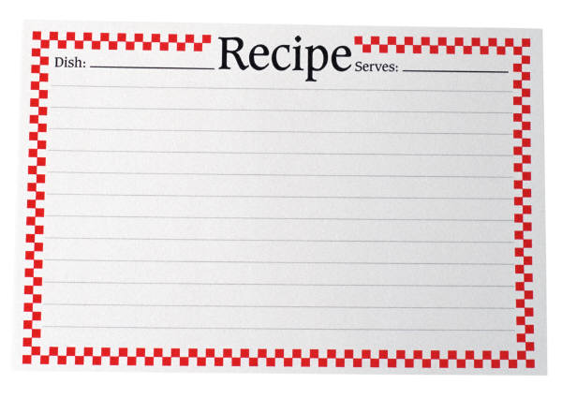

Classes vs. Objects
A class is like a blueprint or a recipe for creating objects. It tells the JVM how to make an object (an instance) of that particular type
class Cake {
}
The Class
The JVM
Objects

Slide 72
Types of classes
Static class: In Java, static is a keyword that manage objects in the memory. The static object belongs to the class instead of the instance of the class.
We can make a class static if and only if it is a nested class. We can also say that static classes are known as nested classes. It means that a class that is declared as static within another class is known as a static class. Nested static class does not require reference to the outer class. The purpose of a static class is to provide the outline of its inherited class
Static class cannot be inherited. Static classes cannot contain an instance constructor. However, they can contain a static constructor. Static classes can only be used in case of nested classes.
Properties
The class has only static members.
It cannot access the member (non-static) of the outer class.
We cannot create an object of the static class.
Nested class/inner class: A class inside another class. The inner class can be static or non static. This can be defined also as a class declared entirely within the body of another class or interface.

Slide 73
static and non static inner classes examples
class Outer {
public static String message="Hello";
static class NestedDemo {
public static void print() {
System.out.println("Message from Static class:"+message);
}
public void printAgain() {
System.out.println("Message Again: "+message);
}
}
public class InnerClass {
// static and non-static members
// of Outer class are accessible in
// this Inner class
public void display() {
System.out.println("Message from non-static"
+ " nested class: "+message);
}
}
}
public class Program2 {
public static void main(String args[]) {
// Call a static Method in static class
Outer.NestedDemo.print();
// call non static method in static class
Outer.NestedDemo demo = new Outer.NestedDemo();
demo.printAgain();
// Creating Outer class instance for creating
// non-static nested class
Outer outer = new Outer();
Outer.InnerClass inner
= outer.new InnerClass();
// Calling non-static method of Inner class
inner.display();
}
}

Slide 74
Types of classes
Final class: A final class in Java is a concept of object-oriented programming where a class is declared using the "final" keyword. This type of class cannot be extended or inherited by other classes, making it inflexible
Abstract classes are similar to interfaces. You cannot instantiate them, and they may contain a mix of methods declared with or without an implementation. However, with abstract classes, you can declare fields that are not static and final, and define public, protected, and private concrete methods
Concrete class: A concrete class is a class that has an implementation for all of its methods. They cannot have any unimplemented methods. It can also extend an abstract class or implement an interface as long as it implements all their methods. It is a complete class and can be instantiated.

Slide 75
Types of classes
Singleton class: A singleton class is a class which can be instantiated once, and can be accessed globally. This single instance can be shared throughout our application, which makes Singletons great for managing global state in an application.
POJO
POJO in Java stands for Plain Old Java Object. POJO class. A class that contains only private variables and setter and getter methods to use those variables is called POJO (Plain Old Java Object) class. It is an ordinary object, which is not bound by any special restriction. The POJO file does not require any special classpath. It increases the readability & re-usability of a Java program
OJO is an object which encapsulates Business Logic.
Generally, a POJO class contains variables and their Getters and Setters.
The POJO classes are similar to Beans as both are used to define the objects to increase the readability and re-usability. The only difference between them that Bean Files have some restrictions but, the POJO files do not have any special restrictions.

Slide 76
Class syntax
. A simplified general form of a class definition is shown ere:
class classname{
type instance_variable1;
type instance_variable2;
//…
type instance_variable;
type method_name1(parameter_list){
//body of method
}
type method_name2(parameter_list){
//body of method
}
type method_name3(parameter_list){
//body of method
}
}
All methods have the general for as main() method, which we used previously. However, most methods will not be specified as static or public. Notice that the general form of a class does not specify the main() method. Java classes do not need to have a main() method. You only need to specify one if that class is the starting point for your program. Further, some kinds of Java applications don’t require a main() method at all.
A simple class.
Here is an example of a Box class with width, height and depth but not contain any method.
class Box{
double width;
double height;
double depth;
}

Slide 77
As stated, a class defines a new type of data. In this case, the new data type is called Box. You will use this name to declare objects of type Box. It is important to remember that a clas sdeclaration only creates a template; it does not create an actual object. Thus, the preceding code does not cause any objects of type Box to come into existence.To actually create a Box object, you will use a statement like the following:
Box mybox = new Box (); // create a Box object called mybox
After this statement executes, mybox will refer to an instance of Box. Thus, it will have "physical" reality. For the moment, don't worry about the details of this statement. As mentioned earlier, each time you create an instance of a class, you are creating an object that contains its own copy of each instance variable defined by the class. Thus, every Box object will contain its own copies of the instance variables width, height, and depth.
To access these variables, you will use the dot (.) operator. The dot operator links the name of the object with the name of an instance variable. For example, to assign the width variable of mybox the value 100, you would use the following statement: mybox.width = 100;
This statement tells the compiler to assign the copy of width that is contained within the mybox object the value of 100. In general, you use the dot operator to access both the instance variables and the methods within an object. One other point: Although commonly referred to as the dot operator, the formal specification for Java categorizes the. as a separator.

Slide 78
Complete Box program
.Here is a complete program that uses the Box class:
A program that uses the Box class.
Call this file BoxDemo.java*/
class Box{
double width;
double height;
double depth;
}
// This class declares an object of type Box.
class BoxDemo {
public static void main(String [] args) {
Box mybox = new Box();
double vol;
// assign values to mybox's instance variables
mybox.width = 10
;mybox.height = 20
;mybox.depth = 15;
//compute volume of box
vol = mybox.width * mybox.height * mybox.depth;
System.out.println ("Volume is " + vol);
}
}
You should call the file that contains this program BoxDemo.java, because the main()method is in the class called BoxDemo, not the class called Box. When you compile this program, you will find that two .class files have been created, one for Box and one for BoxDemo.
The Java compiler automatically puts each class into its own.class file. It is not necessary for both the Box and the BoxDemo class to actually be in the same source file. You could put each class in its own file, called Box.java and BoxDemo.java, respectively.To run this program, you must execute BoxDemo.class. When you do, you will see the following output:Volume is 3000.0

Slide 79
Constructors
class Coordinate {
int x, y;
Coordinate() {
x = 0;
y = 0;
}
}
Sometimes we need to given the JVM some extra instructions on how to create an instance of a class
A constructor is a method which has the same name as the class, and no return type
We can use it to initialize data members…

Slide 80
Constructors: Default vs. Explicit
A default constructor is one that has no parameters
An explicit constructor is one that takes parameters, and these are usually used to initialize the data members
class Coordinate {
int x, y;
// Default
Coordinate() {
this.x = 0;
this.y = 0;
}
// Explicit
Coordinate(int x, int y) {
this.x = x;
this.y = y;
}
}

Slide 81
Constructors: Implicit
If you don’t specify any constructors in your class, the compiler will create an implicit default constructor automatically
It's just an empty default constructor
class Coordinate {
int x, y;
}
Coordinate() {
}

Slide 82
Something new…
new is a Java keyword which tells the JVM to create an new object of a given class type
It's always followed by a constructor (default, explicit or implicit), which it calls to create the object
Coordinate c = new Coordinate(2, 4);
String s = new String("Hello");
Integer i = new Integer(3);

Slide 83
Reference vs Object
When we create an object, we usually assign a reference to it to a variable, i.e.
c is a variable – a reference to the object which now exists in memory. We can assign it a new different object…
and then the first one will be lost!
Coordinate c = new Coordinate(2, 4);
c = new Coordinate(8, -2);

Slide 84
This is a keyword
The this keyword is used within methods to access the current class
It can be used to differentiate between instance variables and method parameters that have the same name, e.g.
class Shape {
int color;
void setColor(int color) {
this.color = color;
}
}

Slide 85
Inheritance
Inheritance enables us to share functionality between different classes, and thus avoid duplication of code
We should look for generalizations that can be made about our classes, e.g. if we have a Patient class and Doctor class, and they both have names, DOBs etc, then we could extract that data to a more general superclass called User
A class that is derived from another class is called a subclass (also a derived class, extended class, or child class). The class from which the subclass is derived is called a superclass (also a base class or a parent class).
Excepting Object, which has no superclass, every class has one and only one direct superclass (single inheritance). In the absence of any other explicit superclass, every class is implicitly a subclass of Object.
Classes can be derived from classes that are derived from classes that are derived from classes, and so on, and ultimately derived from the topmost class, Object. Such a class is said to be descended from all the classes in the inheritance chain stretching back to Object.

Slide 86
Inheritance(next)
The idea of inheritance is simple but powerful: When you want to create a new class and there is already a class that includes some of the code that you want, you can derive your new class from the existing class. In doing this, you can reuse the fields and methods of the existing class without having to write (and debug!) them yourself.
A subclass inherits all the members (fields, methods, and nested classes) from its superclass. Constructors are not members, so they are not inherited by subclasses, but the constructor of the superclass can be invoked from the subclass.
A subclass does not inherit the private members of its parent class. However, if the superclass has public or protected methods for accessing its private fields, these can also be used by the subclass.

Slide 87

Duplication = Wasted time
Sometimes a class would require some of the same variables and methods as another class
Duplicating code is ALWAYS bad
Programmers needed a way to share members between different classes, so someone invented inheritance

Slide 88
Duplication = Wasted time
Supposing we created a set of classes for different shapes. Much of our code might be duplicated…
class Square {
int color
int width
int height
getColor(){..}
setColor(){..}
}
class Circle {
int color
int radius
getColor(){..}
setColor(){..}
}
class Triangle {
int color
int width
int height
getColor(){..}
setColor(){..}
}

Slide 89
Inheritance to the rescue!
We start by extracting all the variables and methods that are common to all shapes
class Shape {
int color
getColor(){..}
setColor(){..}
}
class Square {
int width
int height
}
class Circle {
int radius
}
class Triangle {
int width
int height
}

Slide 90
What a subclass can do
A subclass inherits all of the public and protected members of its parent, no matter what package the subclass is in. If the subclass is in the same package as its parent, it also inherits the package-private members of the parent. You can use the inherited members as is, replace them, hide them, or supplement them with new members:
The inherited fields can be used directly, just like any other fields.
You can declare a field in the subclass with the same name as the one in the superclass, thus hiding it (not recommended).
You can declare new fields in the subclass that are not in the superclass.
The inherited methods can be used directly as they are.
You can write a new instance method in the subclass that has the same signature as the one in the superclass, thus overriding it.
You can write a new static method in the subclass that has the same signature as the one in the superclass, thus hiding it.
You can declare new methods in the subclass that are not in the superclass.
You can write a subclass constructor that invokes the constructor of the superclass, either implicitly or by using the keyword super.

Slide 91
Extending a class
Then we use the extends keyword (in Java) to tell the compiler that Square, Circle and Triangle should inherit all the functionality from Shape
class Shape {
int color
getColor(){..}
setColor(){..}
}
class Square extends Shape {
int width
int height
}
class Circle extends Shape {
int radius
}
class Triangle extends Shape {
int width
int height
}

Slide 92
A Family Tree
Parent
class Shape {
int color
getColor(){..}
setColor(){..}
}
Superclass
Children
Subclasses
class Square extends Shape {
int width
int height
}
class Circle extends Shape {
int radius
}
class Triangle extends Shape {
int width
int height
}

Slide 93
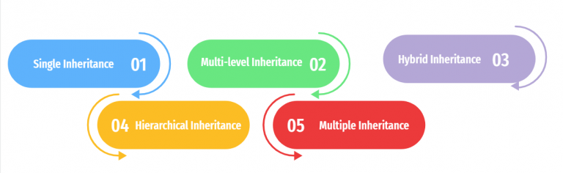
Types of Inheritance
Java support different types of inheritance, refer to the link below for more details.
https://shorturl.at/fKXZ1

Slide 94
Circle is a Shape
Circle doesn't just import functionality from Shape, Circle is a Shape, so we can do this…
The object created by the JVM is of type Circle, but we can reference it with variable of type Shape
Shape c = new Circle();
int i = c.getColor();

Slide 95
But Shape is not a Circle!
Inheritance goes one way – Shape is not a kind of Circle, so this won't compile…
And this definitely won't work (Circle and Triangle are siblings)
Circle c = new Shape(); // Error!!!!
Circle c = new Triangle(); // Error!!!!

Slide 96
Every object is an Object…
Anytime you create a class in Java, it automatically inherits from a class called Object
So every class is related!
class Object
class Shape
class Square
Object o = new Shape(); // Works!!

Slide 97
Casting Primitives…
Casting means converting from one data type to another. We can do it with primitive types…
byte b = 34;
int n = b; // Implicit cast
int m = (int)b; // Explicit cast
byte c = (byte)n; // Explicit cast
byte d = n; // Error !!!

Slide 98
Casting Objects…
We can also cast objects as long as the object being cast is what we're casting it to!
The above code works because Square is a Shape
Square q = new Square();
Shape s = q; // Implicit cast
Shape t = (Shape)q; // Explicit cast

Slide 99
Casting Objects…
But what if the reference type isn't exactly the same as the object type?
The compiler will throw an error if you try an implicit cast
But the JVM will do th e cast, as long as the actual object is of the right type…
Shape s = new Square();
Object o = new Square();
Square t = s; // Compiler Error
Square q = (Square)s; // Works!!!
Square r = (Square)o; // Works!!!

Slide 100
Modifiers in java
There are two types of modifiers in Java: access modifiers and non-access modifiers.
The access modifiers in Java specify the accessibility or scope of a field, method, constructor, or class. We can change the access level of fields, constructors, methods, and class by applying the access modifier on it.
There are four types of Java access modifiers:
Private: The access level of a private modifier is only within the class. It cannot be accessed from outside the class.
Default: The access level of a default modifier is only within the package. It cannot be accessed from outside the package. If you do not specify any access level, it will be the default ie :package protected .
Protected: The access level of a protected modifier is within the package and outside the package through child class. If you do not make the child class, it cannot be accessed from outside the package.
Public: The access level of a public modifier is everywhere. It can be accessed from within the class, outside the class, within the package and outside the package.
There are many non-access modifiers, such as static, abstract, synchronized, native, volatile, transient, etc. The use of non-access modifiers will be covered later, do not worry for this by now.

Slide 101
Access Modifiers
Access Modifier | within class | within package | outside package by subclass only | outside package
Private | Y | N | N | N
Default | Y | Y | N | N
Protected | Y | Y | Y | N
Public | Y | Y | Y | Y

Slide 102
Public and Private
We can control who can access the instance variables and methods of our classes
public means that all other classes can access the variable/method
private means that only the class itself can access the variable/method
class Shape {
public int color;
private int opacity;
}

Slide 103
Protected
protected means that the members are only accessible within the class and within all subclasses
class Shape {
protected int color; // Declared protected
}
class Square extends Shape {
// color is accessible here
}

Slide 104
Package-private (the default)
If we don't specify an access modifier explicitly, then that member is package-private
package intro;
class Shape {
int color; // Will be package-private
}
class AnotherClass {
// color is accessible here because we're in the
// same package
}

Slide 105
Overriding Methods and Variables
When you extend a class, to create a subclass, you can override some of its methods or variables
An overridden method has the same name, parameters and return type as the method it is overriding
When you call the method on an instance of the subclass, even if the reference is of the superclass type, the JVM will execute the overridden method in the subclass

Slide 106
Overriding Methods and Variables
For example….
class Shape {
public void Print() { System.out.println("Shape");}
}
class Square extends Shape {
public void Print() {System.out.println("Square");}
}
Square q = new Square();
Shape s = (Shape)q;
q.Print();
s.Print();
Outputs…
Square
Square

Slide 107
Preventing overriding with final
You can prevent subclasses from overriding methods or variables using the final keyword
class Shape {
public final void Print() {
System.out.println("Shape");
}
}
class Square extends Shape {
public void Print() {…} // Compiler error!
}

Slide 108
That's super!
The super keyword is used to access the members of the superclass from a subclass
It can be used within a method to call a method in the superclass…
class Shape {
public void Print() { System.out.println("Shape");}
}
class Square extends Shape {
public void Print() {
super.Print();
System.out.println("Square");
}
}

Slide 109
That's super!
Or it can be used to pass parameters to a constructor of the superclass
Square has to define a constructor which matches Shape's
class Shape {
Shape(int color) {…}
}
class Square extends Shape {
Square(int color) {
super(color);
}
}

Slide 110
Methods and Variables
We can think of methods as what a class does and variables as what a class knows
Methods that are not called by other classes should be private or protected
Variables not accessed by other classes should be private or protected
Methods should not be too long (50 lines?) as long methods are harder to test and maintain

Slide 111

Encapsulation
Encapsulation is about concealing the functionality of a class from other classes
A class should provide an interface of public methods which other classes can call to manipulate that classes data
This means that the functionality of a class can be changed without breaking the entire program

Slide 112
Getters and Setters
It's common practice to prevent direct access to instance variables from other classes, and instead provide getter and setter methods
class Shape {
protected int color;
public void setColor(int color) {
this.color = color;
}
public int getColor() {
return color;
}
}

Slide 113
Why Encapsulation?
We can modify a class without changing how other classes interact with it
We can make a field read-only by only providing a getter
We can protect our class from invalid values by checking values in the setter, e.g.
public void setColor(int color) {
if (color >= 0)
this.color = color;
}

Slide 114

Packages
Packages in Java are like namespaces in other languages. There are used to:
Group related classes together – e.g. all the classes in a particular project
Differentiate between classes from different sources – e.g. if you create a class which has the same name as another class in a library you are using
You can call your packages whatever you like, but if your code is going to be made publically available, you'll want to choose package names that are unique
Sun recommends that you combine your company's TLD, domain name, and package name, e.g.
Com,mycompany.mystem
rw.ac.rca.mis

Slide 115
Inheritance:Example 2
Previously we java seen example of inheritance using Shape class and derived classes Circle, Triangle, Square and Rectangle.
In the following example we are going to create a Person class and then create a new classes Employee and Student by inheriting the features of the Person class using the "extends" keyword.
Additional Information
The Person class contains four data members' firstName, lastName, and age. Then we created the Employee class by inheriting the Person class, The Employee class has some additional data members, are institution, position and salary while the Student has a school, grade and a combination.
Within Employee we can initialise the data members of Person using Constructors, Employee and Student class Constructor can now call superclass Person constructor using super.
Here are Real situation
A student is a Person
An Employee is a Person
A Person is an Object. The same as a Student or an Employee
A Person is not a Student (i.e Every Person is not an a Student)
A Person is not an Employee(i.e Every Person is not an Employee)

Slide 116
Parent class Person
package rw.ac.rca.mis;
public class Person {
protected int age;
protected String firstName;
protected String lastName;
public Person() {}
public Person(int age,String firstName, String lastName) {
this.age=age;
this.firstName = firstName;
this.lastName = lastName;
}
public Person(String firstName, String lastName) {
this.firstName=firstName;
this.lastName=lastName;
}
public int getAge() {
return age;
}
public void setAge(int age) {
this.age = age;
}
//Continue on the right
public String getFirstName() {
return firstName;
}
public void setFirstName(String firstName) {
this.firstName = firstName;
}
public String getLastName() {
return lastName;
}
public void setLastName(String lastName) {
this.lastName = lastName;
}
public String toString() {
return this.firstName+" "
+ this.lastName+ " is "+ this.age+ " Years old";
}
}
Person

Slide 117
Create Employee extending Person
package rw.ac.rca.mis;
public class Employee extends Person{
private String institution;
private String position;
private long salary;
public String getInstitution() {
return institution;
}
public void setInstitution(String institution) {
this.institution = institution;
}
public String getPosition() {
return position;
}
public void setPosition(String position) {
this.position = position;
}
public long getSalary() {
return salary;
}
public void setSalary(long salary) {
this.salary = salary;
}
@Override
public String toString() {
return "Employee [institution=" + institution + ", position=" + position + ", salary=" + salary + ", age=" + age+ ", firstName=" + firstName + ", lastName=" + lastName + "]";
}
}

Slide 118
Create Student extending Person
package rw.ac.rca.mis;
public class Student extends Person{
private String grade;
private String school;
private String combination;
public String getGrade() {
return grade;
}
public void setGrade(String grade) {
this.grade = grade;
}
public String getSchool() {
return school;
}
public void setSchool(String school) {
this.school = school;
}
public String getCombination() {
return combination;
}
public void setCombination(String combination) {
this.combination = combination;
}
@Override
public String toString() {
return "Student [grade=" + grade + ", school=" + school + ", combination=" + combination + ", age=" + age
+ ", firstName=" + firstName + ", lastName=" + lastName + "]";
}
}

Slide 119
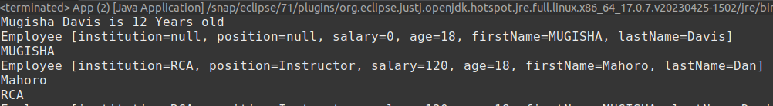
App
package rw.ac.rca.mis;
public class App {
public static void main(String[] args) {
// Create a Person
Person peter=new Person(12, "Mugisha","Davis");
System.out.println(peter);
// Create a Person of type Employee with a Default Constructor
//Not Possible to set additional information of employee
Person p1=new Employee();
p1.setFirstName("MUGISHA");
p1.setLastName("Davis");
p1.setAge(18);
System.out.println(p1);
System.out.println(p1.getFirstName());
//Create Employee, Now you can set all properties of employee
Employee p2=new Employee();
p2.setAge(18);
p2.setFirstName("Mahoro");
p2.setLastName("Dan");
p2.setInstitution("RCA");
p2.setSalary(120);
p2.setPosition("Instructor");
System.out.println(p2);
System.out.println(p2.getFirstName());
System.out.println(p2.getInstitution());
}
}
At this Level we can use the default Constructors of Subclass to create the Object.
Secondly we will provide Subclass object details using setters and we will get the details using getters. We can also print the object using toString() method.
Output

Slide 120
Employee Constructor Initialisation(Explicit)
The constructors for Employee and Student explicitly
initialize the age,firstName, lastName fields of Person.
This technique duplicates code found in its superclass, which is inefficient, but it implies that a subclass must be granted access to these members.

Slide 121
Employee subclass:Explicit member initialisation
package rw.ac.rca.mis;
public class Employee extends Person{
private String institution;
private String position;
private long salary;
public Employee() {
}
public Employee(String institution, String position, long salary,int age, String firstName, String lastName) {
//Initialise members of Employee
this.age=age;
this.firstName=firstName;
this.lastName=lastName;
this.institution=institution;
this.position=position;
this.salary=salary;
}
public String getInstitution() {
return institution;
}
public void setInstitution(String institution) {
this.institution = institution;
}
public String getPosition() {
return position;
}
public void setPosition(String position) {
this.position = position;
}
public long getSalary() {
return salary;
}
public void setSalary(long salary) {
this.salary = salary;
}
@Override
public String toString() {
return "Employee [institution=" + institution + ", position=" + position + ", salary=" + salary + ", age=" + age+ ", firstName=" + firstName + ", lastName=" + lastName + "]";
}
}

Slide 122
Student subclass:Explicit member initialisation
package rw.ac.rca.mis;
public class Student extends Person{
private String grade;
private String school;
private String combination;
public Student() {
}
public Student(int age, String firstName, String lastName, String grade, String school, String combination) {
this.age=age;
this.firstName=firstName;
this.lastName=lastName;
this.grade = grade;
this.school = school;
this.combination = combination;
}
public Student(String firstName, String lastName, String grade, String school, String combination) {
this.firstName=firstName;
this.lastName=lastName;
this.grade = grade;
this.school = school;
this.combination = combination;
}
public String getGrade() {
return grade;
}
public void setGrade(String grade) {
this.grade = grade;
}
public String getSchool() {
return school;
}
public void setSchool(String school) {
this.school = school;
}
public String getCombination() {
return combination;
}
public void setCombination(String combination) {
this.combination = combination;
}
@Override
public String toString() {
return "Student [grade=" + grade + ", school=" + school + ", combination=" + combination + ", age=" + age
+ ", firstName=" + firstName + ", lastName=" + lastName + "]";
}
}

Slide 123
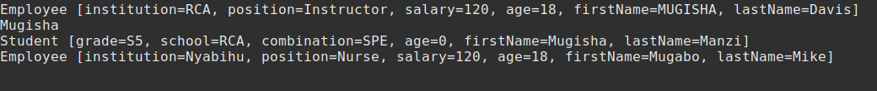
App: Creating Person, Employee and Student Objects
package rw.ac.rca.mis;
public class App {
public static void main(String[] args) {
/Create a Person of Type Employee using a parameterized constructor
Person p3=new Employee("RCA","Instructor",120, 18,"MUGISHA","Davis");
System.out.println(p3);
//Create a Student
Person p4=new Student("Mugisha","Manzi","S5","RCA","SPE");
System.out.println(p4.getFirstName());
System.out.println(p4);
//Everything is an Object
Object p5=new Employee("Nyabihu","Nurse",120,18,"Mugabo","Mike");
System.out.println(p5);
}
}
Output

Slide 124
We need Super
We need to avoid duplication of superclass code. There will be times when you will want to create a superclass that keeps the details of its implementation to itself (that is, that keeps its data members private). In this case, there would be no way for a subclass to directly access or initialize these variables on its own. Since encapsulation is a primary attribute of OOP, it is not surprising that Java provides a solution to this problem. Whenever a subclass needs to refer to its immediate superclass, it can do so by use of the keyword super.
super has two general forms. The first calls the superclass' constructor. The second is used to access a member of the superclass that has been hidden by a member of a subclass.

Slide 125
Super: Create an Employee Constructor
package rw.ac.rca.mis;
public class Employee extends Person{
private String institution;
private String position;
private long salary;
public Employee() {
//Call Person default Constructor
super();
}
/**
* @param age
* @param firstName
* @param lastName
* @param institution
* @param position
* @param salary
*/
public Employee(int age, String firstName, String lastName, String institution, String position, long salary) {
super(age, firstName, lastName);
this.institution = institution;
this.position = position;
this.salary = salary;
}
Employee() calls super() with the arguments age, firstName and lastName. This causes the Person
constructor to be called, which initializes age, firstName, lastName using these values.
Employee no longer initializes these values itself. It only needs to initialize the value unique
to it: institution, position, salary.
This leaves Person free to make these values private if desired. In the preceding example, super() was called with three arguments. Since constructors
can be overloaded, super() can be called using any form defined by the superclass. The constructor executed will be the one that matches the arguments. For example, here is a complete implementation of Employee that provides constructors for the various ways.

Slide 126
Super: Create a Student Constructor
package rw.ac.rca.mis;
public class Student extends Person{
private String grade;
private String school;
private String combination;
public Student() {
super();
}
public Student(int age, String firstName, String lastName, String grade, String school, String combination) {
super(age, firstName, lastName);
this.grade = grade;
this.school = school;
this.combination = combination;
}
public Student(String firstName, String lastName, String grade, String school, String combination) {
super(firstName, lastName);
this.grade = grade;
this.school = school;
this.combination = combination;
}
In this second Subclass, Student() Constructor calls super() with the arguments age, firstName and lastName. This causes the Person
constructor to be called, which initializes age, firstName, lastName using these values.
Student no longer initializes these values itself. It only needs to initialize the value unique to it: grade, school, combination.
Since constructors can be overloaded, super() can be called using any form defined by the superclass. The constructor executed will be the one that matches the arguments. In this example with Student; is a complete implementation of Student that provides constructors for the various ways.
The Person class has:
A default which is called using super()
A two parameter constructor called with two arguments
A three parameter constructor called with three parameters in Student

Slide 127
App: Creating Person, Employee and Student Objects(next)
package rw.ac.rca.mis;
public class App {
public static void main(String[] args) {
//Create a Person of Type Employee using a parameterized constructor
Person p3=new Employee("RCA","Instructor",120, 18,"MUGISHA","Davis");
System.out.println(p3);
//Create a Student
Person p4=new Student("Mugisha","Manzi","S5","RCA","SPE");
System.out.println(p4.getFirstName());
System.out.println(p4);
//Everything is an Object
Object p5=new Employee("Nyabihu","Nurse",120,18,"Mugabo","Mike");
System.out.println(p5);
}
}
Console Output

Slide 128
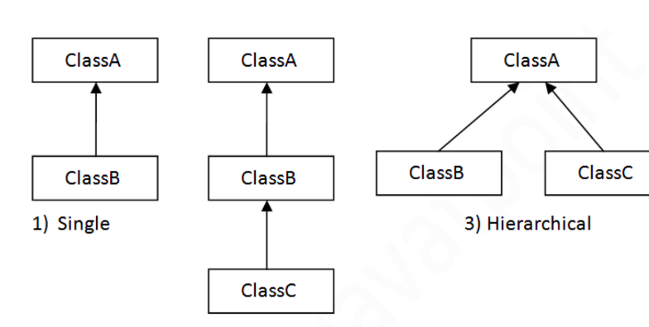
Types of inheritance
On the basis of class, there can be three types of inheritance in java:
single,
multilevel
hierarchical.
In addition for interface only , multiple and hybrid inheritance are also supported

Slide 129
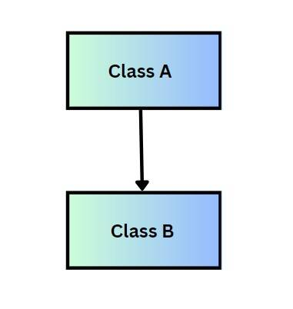
.Single-level inheritance
class Animal{
void eat(){System.out.println("eating...");}
}
class Dog extends Animal{
void bark(){System.out.println("barking...");}
}
class TestInheritance{
public static void main(String args[]){
Dog d=new Dog();
d.bark();
d.eat();
}}
Output:
barking...
eating...
SIngle level inheritance is a fundamental concept where a subclass inherits from only one superclass. This means that the subclass can acquire the properties and methods of the superclass, enabling code reuse and the extension of existing functionality.
Graphically see the image:

Slide 130
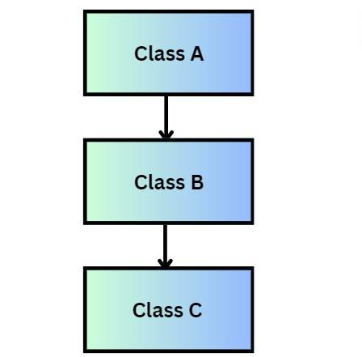
Multilevel Inheritance Example
class Animal{
void eat(){System.out.println("eating...");}
}
class Dog extends Animal{
void bark(){System.out.println("barking...");}
}
class BabyDog extends Dog{
void weep(){System.out.println("weeping...");}
}
class TestInheritance2{
public static void main(String args[]){
BabyDog d=new BabyDog();
d.weep();
d.bark();
d.eat();
}}
Output:
weeping...
barking...
eating...
When there is a chain of inheritance, it is known as multilevel inheritance. As
you can see in the example given below, BabyDog class inherits the Dog
class which again inherits the Animal class, so there is a multilevel
inheritance.

Slide 131
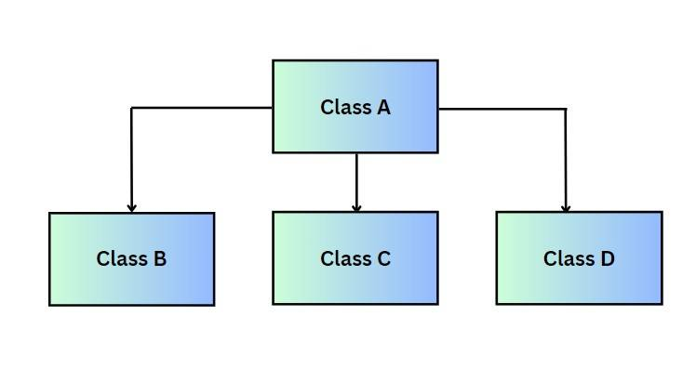
Hierarchical Inheritance
Hierachical inheritance in java occurs when one base class (superclass) is inherited by multiple subclasses. In this type of inheritance, all the features that are common in child classes are included in the base class. This way, the code becomes more manageable and reusable.
class Animal{
void eat(){System.out.println("eating...");}
}
class Dog extends Animal{
void bark(){System.out.println("barking...");}
}
class Cat extends Animal{
void meow(){System.out.println("meowing...");}
}
class TestInheritance3{
public static void main(String args[]){
Cat c=new Cat();
c.meow();
c.eat();
//c.bark();//C.T.Error
}}
Output:
meowing...
eating...

Slide 132
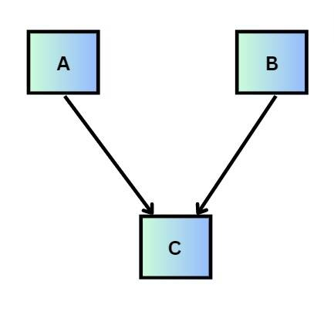
Multiple Inheritance
public interface A {
}
interface B{
}
interface C extends A,B{
}
Multiple inheritance refers to a feature in object-oriented programming where a class can inherit properties and methods from more than one parent class.
However, it's important to note that Java does not support multiple inheritance for classes directly due to the complexity and potential for ambiguity it introduces (such as the "Diamond Problem", where a class inherits from two classes that have a common ancestor, leading to ambiguity in which ancestor's method or property to use).
Instead of multiple inheritance for classes, Java provides a mechanism to achieve polymorphism and code reuse through interfaces.

Slide 133
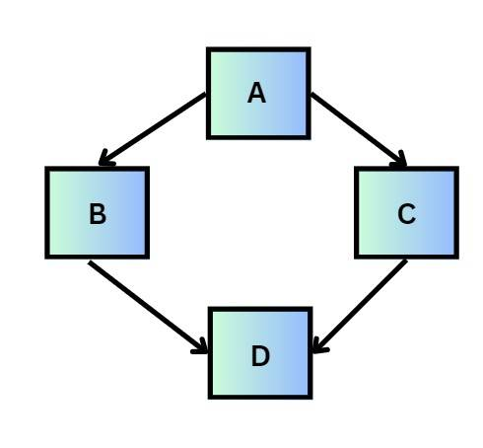
Hybrid Inheritance
In Java, hybrid inheritance can involve:
Single and Multilevel Inheritance through classes: A class inherits from one superclass, and then another class inherits from that subclass, forming a linear inheritance chain.
Hierarchical Inheritance through classes: Multiple classes inherit from a single parent class.
Multiple Inheritance through Interfaces: A class implements multiple interfaces, inheriting the abstract methods from these interfaces.
Combining Class Inheritance and Interface Implementation: A class extends another class and also implements one or more interfaces.
Hybrid inheritance is a combination of two or more types of inheritance, such as hierarchical, multiple, multilevel, or single inheritance. It integrates various inheritance mechanisms to achieve a specific design or functionality.
However, it's important to note that due to Java's restriction on extending multiple classes directly (to avoid complexity and ambiguity issues like the Diamond Problem), hybrid inheritance in Java is primarily achieved through a mix of class inheritance (using the extends keyword) and interface implementation (using the implements keyword).

Slide 134
Abstraction

Slide 135
Abstraction
In Java, Data Abstraction is the property by virtue of which only the essential details are displayed to the user. The trivial or the non-essential units are not displayed to the user.
Abstraction in Java is an important concept that every Java Developer should understand to build robust and efficient software. In simple terms, Abstraction is the process of hiding the implementation details or irrelevant details and showing only the necessary information to the user. One of the most fundamental concepts in Java is Abstraction. This technique is used to simplify the complexity of a program by providing a simpler view of the system. Abstraction in Java is the process of hiding an application's inner workings from the outside world
Data Abstraction may also be defined as the process of identifying only the required characteristics of an object ignoring the irrelevant details. The properties and behaviors of an object differentiate it from other objects of similar type and also help in classifying/grouping the objects

Slide 136
Achieving Abstraction in Java
In Java, abstraction is achieved by interfaces and abstract classes. We can achieve 100% abstraction using interfaces.
Java provides both Abstract classes and Interfaces to achieve Data Abstraction. Interfaces allow for complete Abstraction and maximum flexibility. It means that the implementation details are entirely hidden and abstracted from the user interface, and this approach permits maximum reusability and flexibility.
Abstract classes in Java offer partial to complete Abstraction. It can contain both concrete methods (with implementation) and abstract methods (without implementation). This approach can be helpful in scenarios where some implementation details can be shared among different subclasses.

Slide 137
Advantages of Abstraction I Java
Abstraction is an important feature of object-oriented programming. It is implemented though abstract classes and interfaces. Here are some advantages of Abstraction in Java:
1) Simplifies the complexity of code by hiding the implementation details
2) Provides a way to separate interface from implementation
3) Makes code easier to update and maintain
4) Improves code reusability and readability
5) Provides a clear and concise view of the system architecture
6) Facilitates easier testing and debugging of the code
7) Helps in enforcing guidelines and coding standards
8) Allows for platform independence and cross-language compatibility
9) Provides a way to represent complex real-world entities in a simplified manner
10) Allows for polymorphism and inheritance
11) Allows for code extensibility without modifying the existing code
12) Encourages modular programming and component-based development
13) Provides a way to encapsulate and modularise code
14) Provides a way to hide sensitive information from the end-user
15) Helps in reducing the coupling between components

Slide 138
Abstraction
Inheritance is a very useful feature of Java because it allows us to extract common functionality from classes into super-classes
For example, a Shape class may contain the functionality common to different shape classes, and we can write...
Shape s1 = new Triangle();
Shape s2 = new Circle();
Shape s3 = new Octagon();
Different subclass objects can even be stored in the same static array or collection, e.g.
Shape[] myShapes = new Shape[2];
myShapes[0] = new Triangle();
myShapes[1] = new Circle();

Slide 139
Abstract class
An abstract class is a class that is declared abstract—it may or may not include abstract methods. Abstract classes cannot be instantiated, but they can be subclassed.
An abstract method is a method that is declared without an implementation (without braces, and followed by a semicolon), like this:
abstract void moveTo(double deltaX, double deltaY);
When an abstract class is subclassed, the subclass usually provides implementations for all of the abstract methods in its parent class. However, if it does not, then the subclass must also be declared abstract.

Slide 140
Example
Shape draw()
Triangle
draw()
Square
draw()
Circle
draw()
How would one implement the draw method in the shape class?
Should the shape class ever be instantiated?

Slide 141
Example
abstract class Shape {
public void draw() {}
}
Triangle
draw()
Square
draw()
Circle
draw()
Declaring the class as abstract prevents it from instantiated, i.e.
Shape s = new Shape();
Compiler error

Slide 142
Example
class Rectangle extends Shape {
double length;
double width;
public Rectangle(String color, double length, double width)
{
// calling Shape constructor
super(color);
System.out.println("Rectangle constructor called");
this.length = length;
this.width = width;
}
@Override double area() { return length * width; }
@Override public String toString()
{
return "Rectangle color is " + super.getColor()
+ "and area is : " + area();
}
}
abstract class Shape {
String color;
// these are abstract methods
abstract double area();
public abstract String toString();
// abstract class can have the constructor
public Shape(String color)
{
System.out.println("Shape constructor called");
this.color = color;
}
// this is a concrete method
public String getColor() {
return color; }
class Circle extends Shape {
double radius;
public Circle(String color, double radius)
{
// calling Shape constructor
super(color);
System.out.println("Circle constructor called");
this.radius = radius;
}
@Override double area()
{
return Math.PI * Math.pow(radius, 2);
}
@Override public String toString()
{
return "Circle color is " + super.getColor()
+ "and area is : " + area();
}
}
public class Test {
public static void main(String[] args)
{
Shape s1 = new Circle("Red", 2.2);
Shape s2 = new Rectangle("Yellow", 2, 4);
System.out.println(s1.toString());
System.out.println(s2.toString());
}
}
Shape constructor called
Circle constructor called
Shape constructor called
Rectangle constructor called
Circle color is Redand area is : 15.205308443374602
Rectangle color is Yellowand area is : 8.0

Slide 143
Abstract methods
abstract class Shape {
public abstract void draw();
}
Methods can also be declared abstract
This means that they don't have an implementation
Subclasses MUST provide an implementation or be abstract themselves.
A class with any abstract methods must be abstract itself, e.g.
class Shape {
public abstract void draw();
}
Wrong: A class with abstract methods must be abstract
abstract class Shape {
public abstract void draw();
public String toString() {
return "Shape";
}
}
OK: An abstract class can have a mixture of abstract and normal methods

Slide 144
Abstract methods
abstract class Shape {
public abstract void draw();
}
OK: A subclass can implement all abstract methods
class Square extends Shape {
public void draw() {
...
}
}
OK: A subclass doesn't have to implement a method if it is abstract as well
abstract class Polygon extends Shape {
}

Slide 145
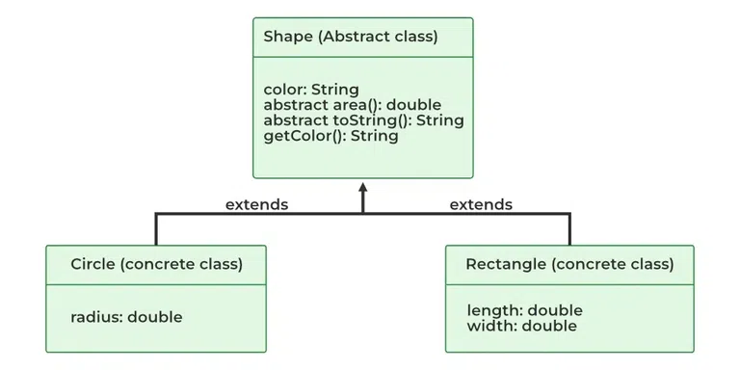
When to use abstract classes?
There are situations in which we will want to define a superclass that declares the structure of a given abstraction without providing a complete implementation of every method. Sometimes we will want to create a superclass that only defines a generalization form that will be shared by all of its subclasses, leaving it to each subclass to fill in the details.
Consider a classic “shape” example, perhaps used in a computer-aided design system or game simulation. The base type is “shape” and each shape has a color, size, and so on. From this, specific types of shapes are derived(inherited)-circle, square, triangle, and so on — each of which may have additional characteristics and behaviors. For example, certain shapes can be flipped. Some behaviors may be different, such as when you want to calculate the area of a shape. The type hierarchy embodies both the similarities and differences between the shapes.

Slide 146
Interface
There are a number of situations in software engineering when it is important for disparate groups of programmers to agree to a "contract" that spells out how their software interacts. Each group should be able to write their code without any knowledge of how the other group's code is written. Generally speaking, interfaces are such contracts.
For example, imagine a futuristic society where computer-controlled robotic cars transport passengers through city streets without a human operator. Automobile manufacturers write software (Java, of course) that operates the automobile—stop, start, accelerate, turn left, and so forth. Another industrial group, electronic guidance instrument manufacturers, make computer systems that receive GPS (Global Positioning System) position data and wireless transmission of traffic conditions and use that information to drive the car.
The auto manufacturers must publish an industry-standard interface that spells out in detail what methods can be invoked to make the car move (any car, from any manufacturer). The guidance manufacturers can then write software that invokes the methods described in the interface to command the car. Neither industrial group needs to know how the other group's software is implemented. In fact, each group considers its software highly proprietary and reserves the right to modify it at any time, as long as it continues to adhere to the published interface.

Slide 147
Why interface?
We've looked at how classes can extend other classes and override their methods and variables
For example: a.foo() will actually call the foo method of B
What if we need our class to inherit the functionality of
more than one superclass?
class A {
public void foo() {
}
}
class B extends A {
public void foo() {
}
}
class App {
App() {
A a = new B();
a.foo();
}
}
class Shape {
int color;
}
class Printable {
void print() {}
}
class Square extends Shape, Printable {
void print() {}
}
Not allowed!

Slide 148

Multiple inheritance
This is allowed in some programming languages such as C++, but NOT in Java
It makes code overly complex
The diamond problem…
class A {
void foo()
}
class B extends A {
void foo() {
}
}
class C extends A {
void foo() {
}
}
class D extends B, C { }

Slide 149
Constructors
D d = new D();
class A {
A(int a) {}
}
class B extends A {
B() {
super(1);
}
}
class C extends A {
C() {
super(2);
}
}
class D extends B, C { }

Slide 150
Interface
public interface OperateCar {
// constant declarations, if any
// method signatures
// An enum with values RIGHT, LEFT
int turn(Direction direction,
double radius,
double startSpeed,
double endSpeed);
int changeLanes(Direction direction, double startSpeed, double endSpeed);
int signalTurn(Direction direction, boolean signalOn);
int getRadarFront(double distanceToCar, double speedOfCar);
int getRadarRear(double distanceToCar, double speedOfCar);
......
// more method signatures
}
In the Java programming language, an interface is a reference type, similar to a class, that can contain only constants, method signatures, default methods, static methods, and nested types. Method bodies exist only for default methods and static methods. Interfaces cannot be instantiated—they can only be implemented by classes or extended by other interfaces
Note that the method signatures have no braces and are terminated with a semicolon.
why use interfaces when we have abstract classes?
The reason is, abstract classes may contain non-final variables, whereas variables in the interface are final, public, and static.

Slide 151
Defining an interface
An interface declaration consists of modifiers, the keyword interface, the interface name, a comma-separated list of parent interfaces (if any), and the interface body. For example:
public interface GroupedInterface extends Interface1, Interface2, Interface3 {
// constant declarations
// base of natural logarithms
double E = 2.718282;
// method signatures
void doSomething (int i, double x);
int doSomethingElse(String s);
}
The public access specifier indicates that the interface can be used by any class in any package. If you do not specify that the interface is public, then your interface is accessible only to classes defined in the same package as the interface.
An interface can extend other interfaces, just as a class subclass or extend another class. However, whereas a class can extend only one other class, an interface can extend any number of interfaces. The interface declaration includes a comma-separated list of all the interfaces that it extends.

Slide 152
The Interface Body
The interface body can contain abstract methods(An abstract method is a method that is declared without an implementation (without braces, and followed by a semicolon)), default methods, and static methods. An abstract method within an interface is followed by a semicolon, but no braces (an abstract method does not contain an implementation). Default methods are defined with the default modifier, and static methods with the static keyword. All abstract, default, and static methods in an interface are implicitly public, so you can omit the public modifier.
In addition, an interface can contain constant declarations. All constant values defined in an interface are implicitly public, static, and final. Once again, you can omit these modifiers
Default methods: https://docs.oracle.com/javase/tutorial/java/IandI/defaultmethods.html

Slide 153
Java solutions: Interfaces
.
You can think of an interface as a 100% abstract class – all the methods are abstract and thus not implemented
We can only extend one class, but we can implement as many interfaces as we want
Interfaces can extend other interfaces, but because they are 100% abstract, they can't override methods
interface Printable {
void print();
}
class Shape {
int color;
}
interface Drawable {
void draw();
}
class Square extends Shape
implements Printable, Drawable {
void print() {}
void draw() {}
}

Slide 154
Inheritance: Extends and implements
interface A {
public void foo();
}
interface B extends A {
public void bar();
}
class App implements B {
public void foo() {}
public void bar() {}
}
When one interface extends another, it inherits its methods
Any implementing class must implement all of the inherited methods as well

Slide 155
Diamond Problem gone…
B and C can't override foo()
Doesn't matter that B and C both define bar()
interface A {
void foo();
}
interface B extends A {
void bar();
}
interface C extends A {
void bar();
}
class D implements B, C {
void foo() {}
void bar() {} }

Slide 156
Interface constant and Visibility
Interfaces cannot include instance variables, but they can include constants
Any variable declared within an interface is implicitly public static final, so these keywords can be omitted
Visibility
Recap: methods and variables within classes default to package-private
However, methods and constants within interfaces default to public
This can lead to compiler errors if you omit access modifiers from your code…
interface A {
double PI = 3.14159;
public static final double E = 2.718282;
}
interface A { void foo(); }
class B implements A {
void foo() {} // Error!! – can't reduce the
// visibility of foo()
}

Slide 157
Default methods
// A simple program to Test Interface default
// methods in java
interface TestInterface
{
// abstract method
public void square(int a);
// default method
default void show()
{
System.out.println("Default Method Executed");
}
}
class TestClass implements TestInterface
{
// implementation of square abstract method
public void square(int a)
{
System.out.println(a*a);
}
public static void main(String args[])
{
TestClass d = new TestClass();
d.square(4);
// default method executed
d.show();
}
}
Before Java 8, interfaces could have only abstract methods. The implementation of these methods has to be provided in a separate class. So, if a new method is to be added in an interface, then its implementation code has to be provided in the class implementing the same interface.
To overcome this issue, Java 8 has introduced the concept of default methods which allow the interfaces to have methods with implementation without affecting the classes that implement the interface.
Default methods can be overriden

Slide 158
static methods
// A simple Java program to TestClassnstrate static
// methods in java
interface TestInterface
{
// abstract method
public void square (int a);
// static method
static void show()
{
System.out.println("Static Method Executed");
}
}
class TestClass implements TestInterface
{
// Implementation of square abstract method
public void square (int a)
{
System.out.println(a*a);
}
public static void main(String args[])
{
TestClass d = new TestClass();
d.square(4);
// Static method executed
TestInterface.show();
}
}
A static method is a method that belongs to a class rather than an instance of a class. This means you can call a static method without creating an object of the class. Static methods are sometimes called class methods.
The interfaces can have static methods as well which is similar to static method of classes.
Static methods can not be overriden

Slide 159
Using interface as a Type
When you define a new interface, you are defining a new reference data type. You can use interface names anywhere you can use any other data type name.
If you define a reference variable whose type is an interface, any object you assign to it must be an instance of a class that implements the Interface.

Slide 160
Improving an interface
Consider an interface that you have developed called DoIt:
public interface DoIt {
void doSomething(int i, double x);
int doSomethingElse(String s);
}
Suppose that, at a later time, you want to add a third method to DoIt, so that the interface now becomes:
public interface DoIt {
void doSomething(int i, double x);
int doSomethingElse(String s);
boolean didItWork(int i, double x, String s);
}
If you make this change, then all classes that implement the old DoIt interface will break because they no longer implement the old interface. Programmers relying on this interface will protest loudly.

Slide 161
Improving an interface
Try to anticipate all uses for your interface and specify it completely from the beginning. If you want to add additional methods to an interface, you have several options. You could create a DoItPlus interface that extends DoIt:
public interface DoItPlus extends DoIt {
boolean didItWork(int i, double x, String s);
}
Now users of your code can choose to continue to use the old interface or to upgrade to the new interface.
Alternatively, you can define your new methods as default methods. The following example defines a default method named didItWork:
public interface DoIt {
void doSomething(int i, double x);
int doSomethingElse(String s);
default boolean didItWork(int i, double x, String s) {
// Method body
}
}
Note that you must provide an implementation for default methods. You could also define new static methods to existing interfaces. Users who have classes that implement interfaces enhanced with new default or static methods do not have to modify or recompile them to accommodate the additional methods.

Slide 162
Encapsulation vs Data Abstraction
Encapsulation is data hiding(information hiding) while Abstraction is detailed hiding(implementation hiding).
While encapsulation groups together data and methods that act upon the data, data abstraction deal with exposing the interface to the user and hiding the details of implementation.
Encapsulated classes are Java classes that follow data hiding and abstraction We can implement abstraction by using abstract classes and interfaces.
Encapsulation is a procedure that takes place at the implementation level, while abstraction is a design-level process.

Slide 163
Question
Consider the inheritance described below:
class A
interface B
interface C
interface D
interface C inherits interface B
class E inherits class A
class E inherits interface C and D
Write appropriate Code to create interface C .
Write appropriate Code to create class E .

Slide 164
Read more
https://www.oracle.com/java/technologies/oop.html
https://www.geeksforgeeks.org/four-main-object-oriented-programming-concepts-of-java/
https://techaffinity.com/blog/oops-concepts-in-java/

